Slide 1
Finnish teachers’ readiness to teach 21st century competencies and financial literacy:
Expectancies, values, and actual skills
Panu Kalmi, University of Vaasa
With Mette Ranta, Milla Kruskopf, Kirsti Lonka, University of Helsinki
and Marilla Kortesalmi, Laurea University of Applied Sciences

Slide 2
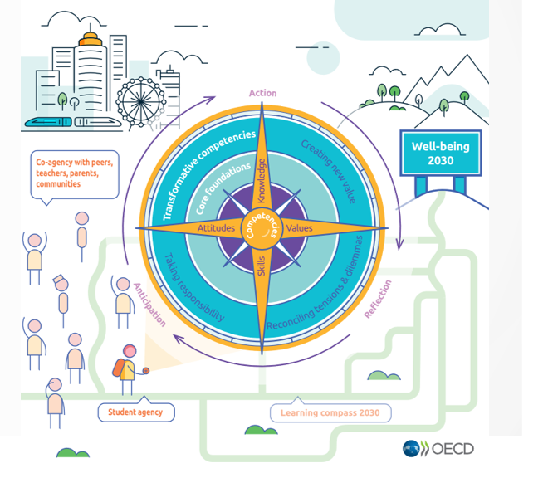
Oecd 21st century skills and learning compass
Skills and competencies that today’s students need to adopt an entrepreneurial attitude to develop new informal learning and socioemotional skills
Competencies include problem solving, managing everyday life, collaboration and communication, and cultural and ethical awareness (Prensky, 2001)

Slide 3
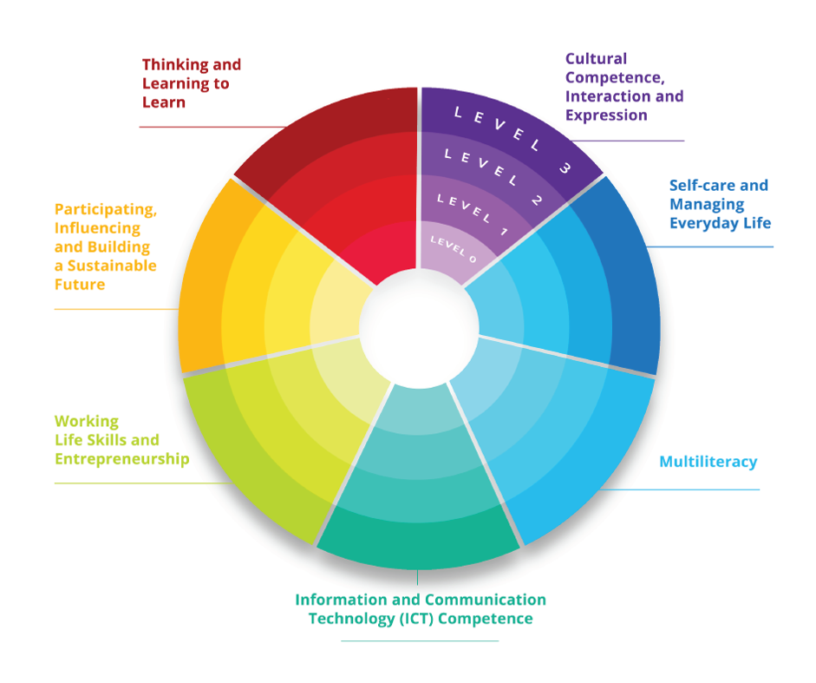
The Finnish 21st century skills in the national curriculum

Slide 4
New financial skills required
These new competencies stressed also in financial education
Complex and digitalized financial landscape
Teachers show great uncertainty in financial knowledge and identify themselves as having a low level of financial literacy overall (Blue et al., 2014; Lee, 2010)
In line with Eccles’ et al. (1983) Expectancy-Value Theory, despite teachers’ perceived interest or their given importance in a subject, they may lack the perceived competence (Burcher et al., 2021; Feather, 1995) in teaching these skills, as well as a lack in actual content knowledge.
Overall, a lack of research on teachers’ understanding, experiences and competencies in teaching financial literacy and future skills (Björklund, 2019; Leumann, 2017)

Slide 5
Financial education in Finland
Interdisciplinary phenomenon-based approach
A large part of economics it is in social studies, but includes also home economics, mathematics, and other subjects
Financial literacy and entrepreneurship are important pillars of economic education in Finnish schools
Financial literacy education in Finland starts already at primary school

Slide 6
Our research questions
How do teacher students perceive the teaching of broad-based curricular competencies (the 21st century skills)?
How do their self-efficacy in teaching and financial literacy (subjective and objective) vary according to their characteristics?

Slide 7
Two different samples
614 teacher-students at the University of Helsinki (RQ1)
104 teachers students at the UH + 17 in-service teachers in teacher training program by University of Vaasa and Laurea University of Applied Sciences

Slide 8
Explanatory variables
Composite variables on teacher self-efficacy, based on Eccles et al. 1983 expectancy theory: interest teaching this, I am good in teaching this, teaching this is part of my studies
Objective financial literacy: based on previous items (see. e.g. Lusardi and Mitchell, 2014); seven-item scale
Subjective perceptions of financial literacy: e.g. Allgood and Walstad (2016)

Slide 9
Results: broad-based competencies
The teacher students find that the competencies are important for their work, and they generally think they are well equipped to teach them.
However, the fields that they clearly find that their competencies are the lowest are related to work-life skills and entrepreneurship.
This chimes with previous studies from Finland that of social science teachers, the issues related to economics are where teachers perceive to have the biggest gaps in their teaching skills.

Slide 10
Results: teaching efficacy and financial literacy
Teaching efficacy (entrepreneurship, consumers skills): ANOVA and regression
There are big differences between in-service and pre-service teachers (students) and age (probably reflecting experience), but not that much according to gender or what they do teach
Subjective financial literacy: strong relationship with age again and between in-service and pre-service teachers, some relationship with subject (teachers teaching economics have stronger financial literacy)
Objective financial literacy: again, age and in-service teaching are positively related to financial literacy, as well as subject teachers are teaching; some differences in gender (males have higher FL, does not survive regression analysis)
Subjective financial literacy is also a strong predictor of objective financial literacy

Slide 11
Conclusions
Finnish teacher-students are interested in broad-based curricular objectives; however, in matters related to economic subjects such as entrepreneurship and collaborating with companies they need more support
Financial literacy skills are build up over time; there might be need for targeted interventions for younger teachers
The Matthew effect: teachers who are most financially literate are the ones most likely to attend any training programs. How to attract also those teachers who are most in need?

